Slide 1
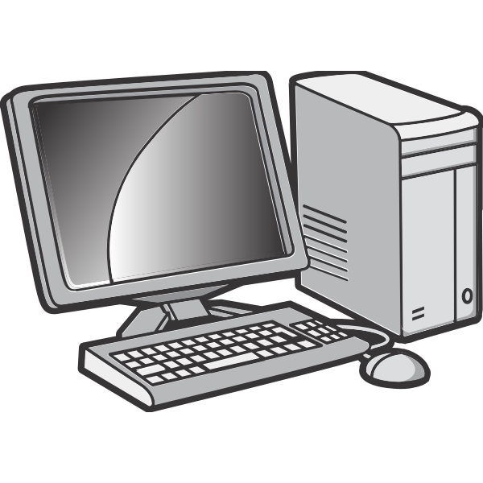


How does the Web work?
HTTP request
HTTP Response: HTML documents
Client: browser
internet server
The Web is a series of interactions between two types of systems, clients and servers that is done via the HTTP protocol.

Slide 2
What do you need to be a Web developer?
A good Web developer must have good grip on technical skills like client-side development (front-end), server-side development (back-end), database technology and version control.
They also need to have decent problem solving and communication skills.
Database Management Systems
Front-End Technologies
Back-end Technologies
Version Control
ReactJS, VueJS, etc
NodeJS, ExpressJS, etc
MySQL, MongoDB, etc
Github, GitLab, etc

Slide 3

What is the role of a Web developer?
A full stack web developer is a person who can develop both client and server software. They rely on using their problem solving skills to deliver web products that meet the clients requirements in time.
Created by: Waad Gharbia

